Slide 1
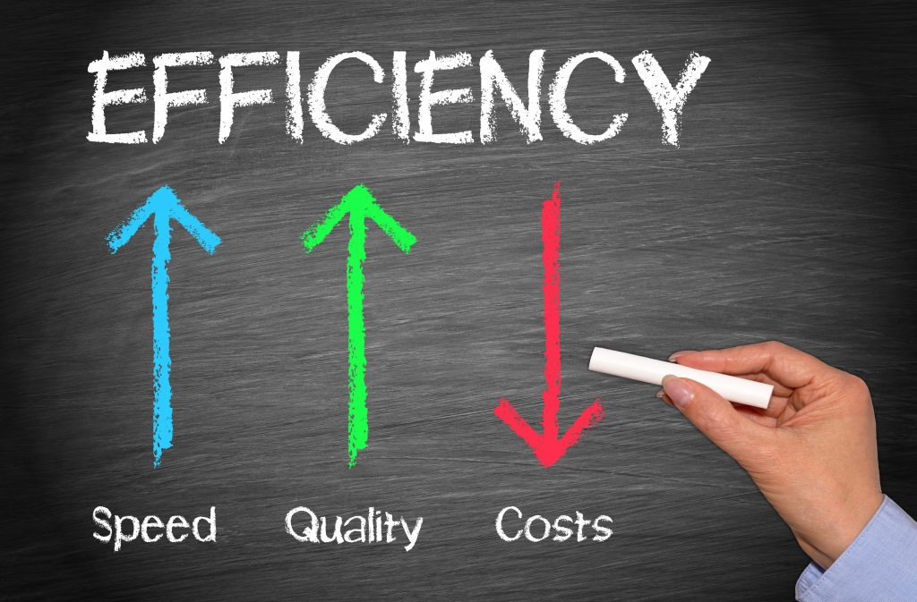


Slide 2
Design
Efficiency
Process
Economic Analysis

Slide 3
Source
- Picture in Introduction
https://blog.mirus.com/menu-engineering-3-tips-to-maximize-profit-margin
https://damienhowellpt.com/efficient-physical-therapy-one-therapists-opinion/#.XduGquhKhPY
The first slide is introduction and the next one is conclusion.

